Slide 1
Enhancing Network Security
Analysis and Recommendations

Slide 2
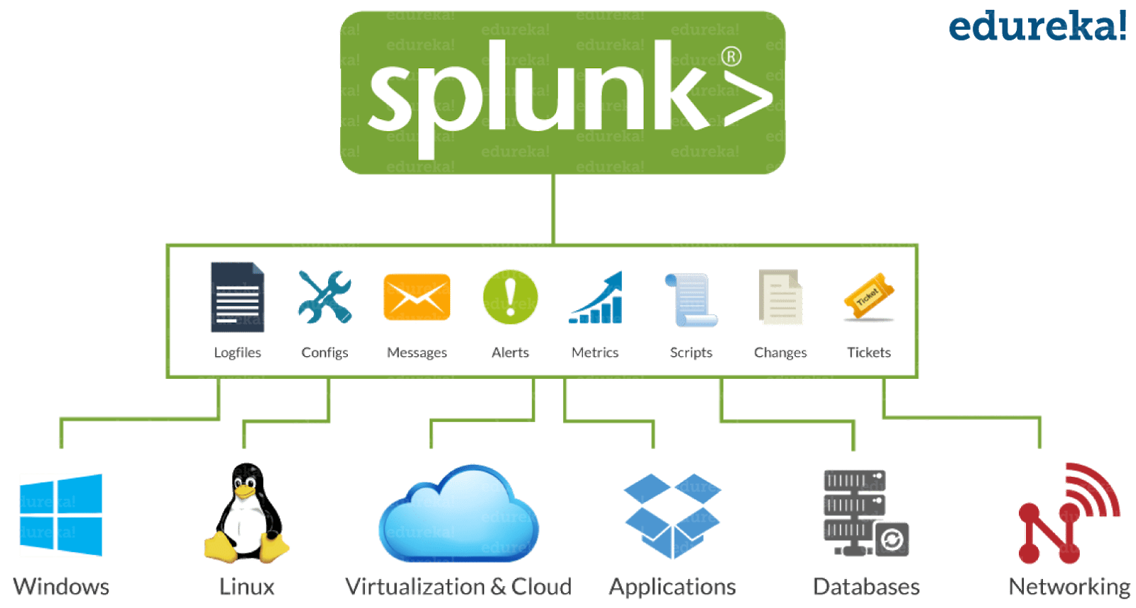
What is Splunk
Common Splunk Port Numbers and Interaction
Common Architecture of Splunk
Query Language Used by Splunk
Types of Search Modules

Slide 3
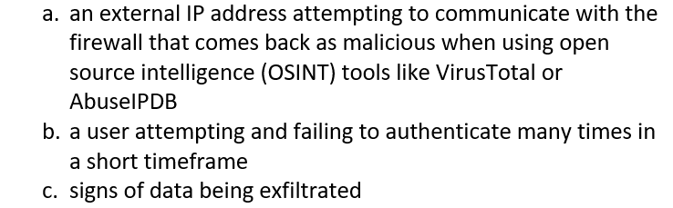

Slide 4
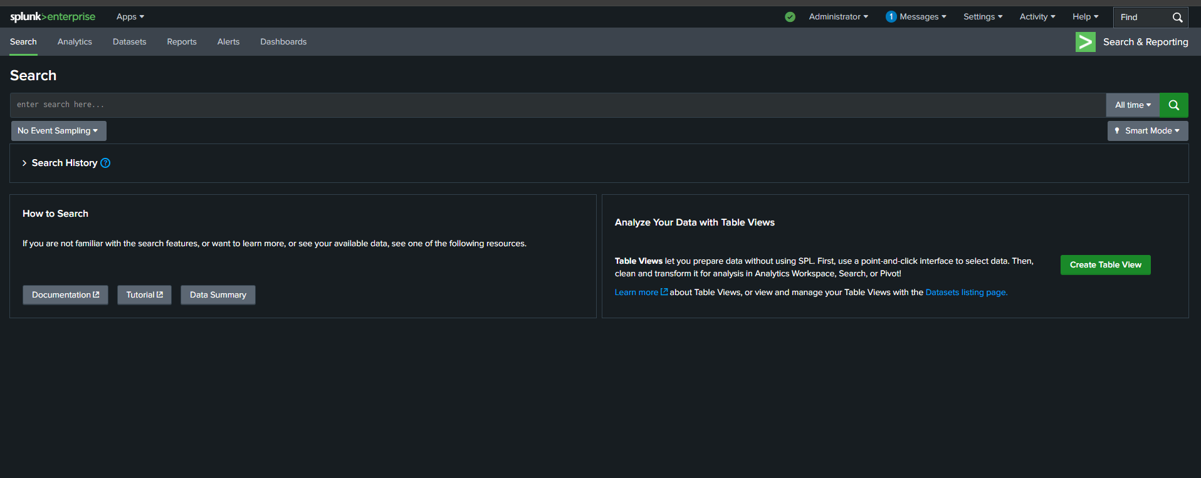
Splunk Interface

Slide 5
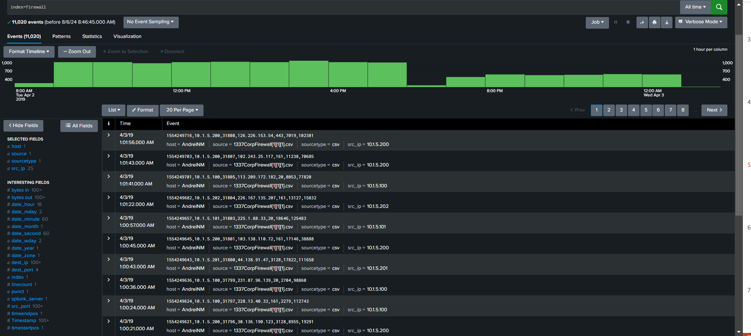

Slide 6
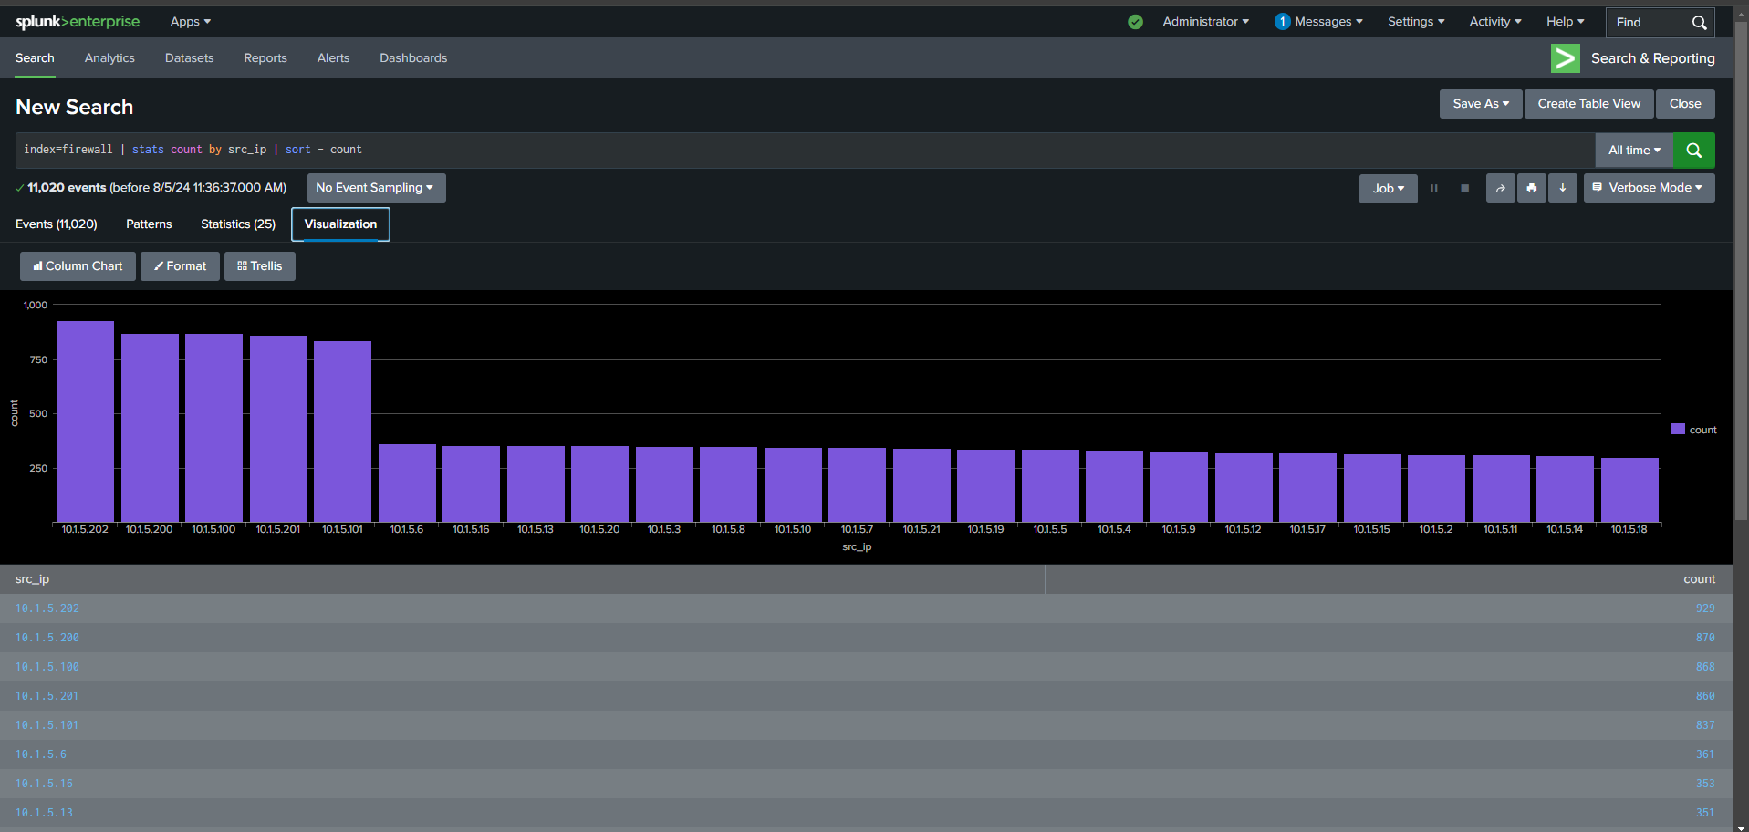
Determinate Local Ips with Splunk
Notes:
Speak about the local subnet, the local IPs and my search query.

Slide 7
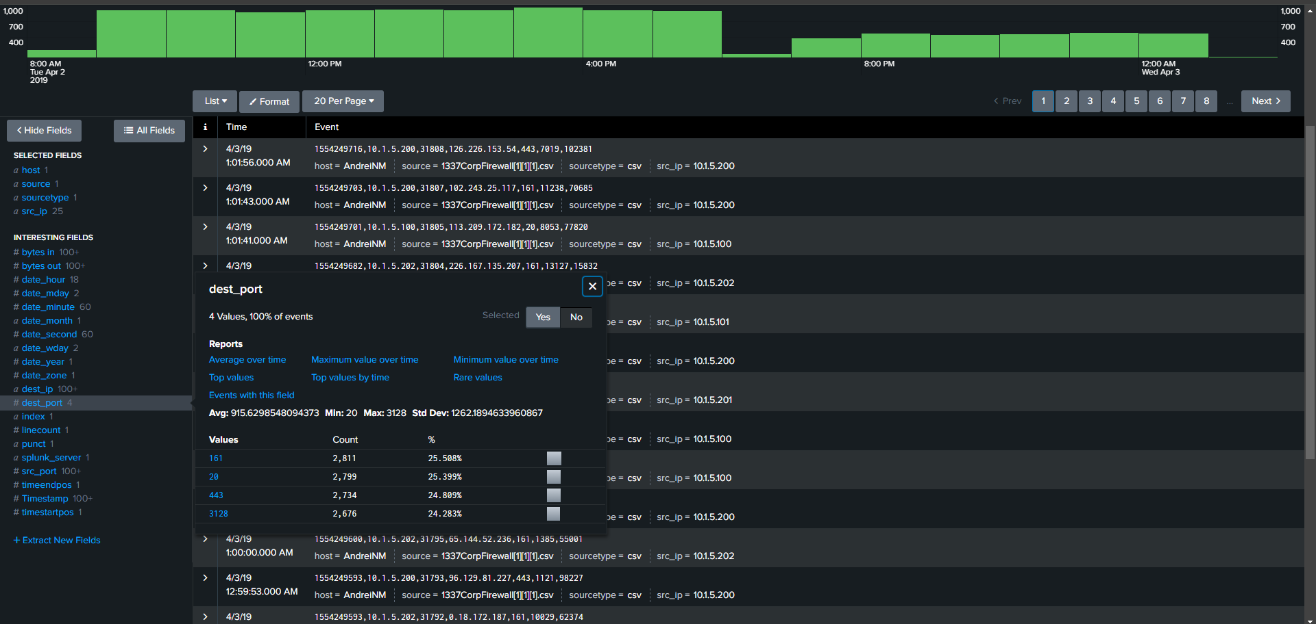

Slide 8
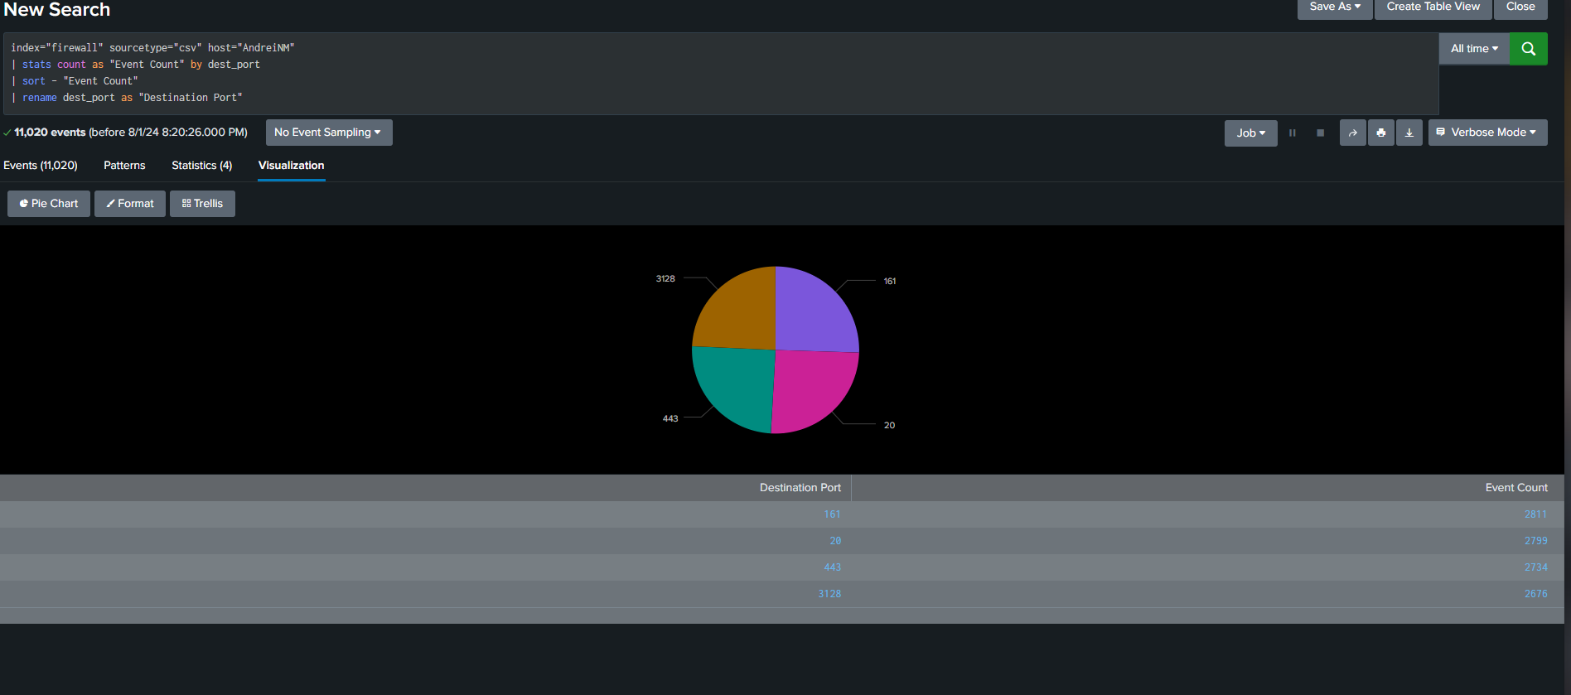

Slide 9
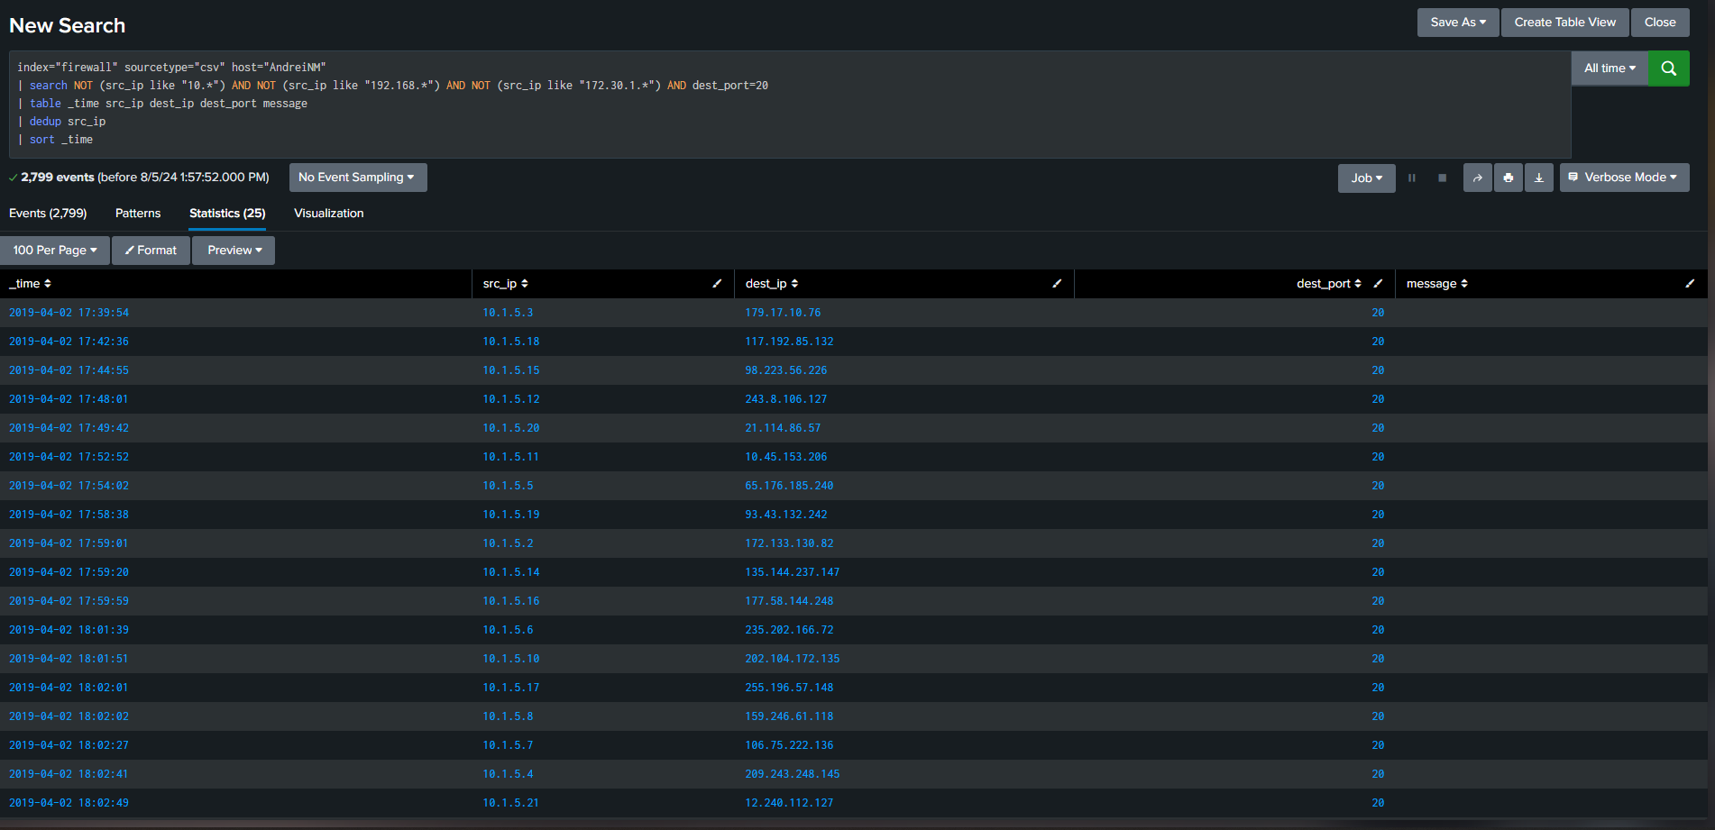
Checking Internal Ip’s
Scan each dest_ip with tools such as VirusTotal, AbuseIPDB and Cisco Talos.
Suspicious Network Activity: Date and Time: April 2, 2019, 17:42:36 | Source IP Address: 10.1.5.18 | Destination IP Address: 117.192.85.132 | Destination Port: 20 (FTP)
2. Suspicious Network Activity: Date and Time: April 2, 2019, 17:59:59 | Source IP Address: 10.1.5.16 | Destination IP Address: 177.58.144.248 | Destination Port: 20 (FTP)

Slide 10
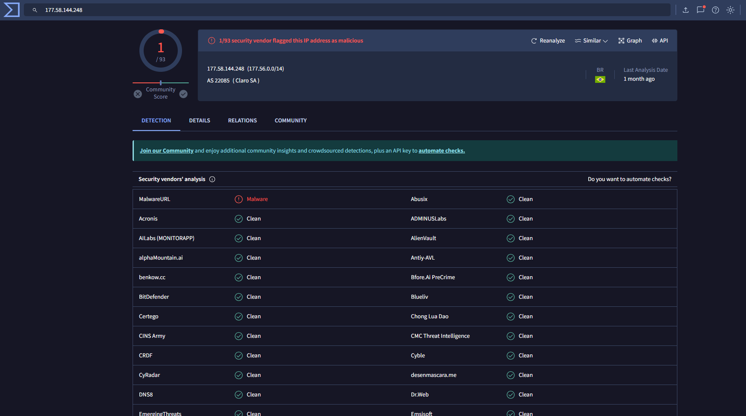
Results from IP Reputation Analysis Using AbuseIPDB, VirusTotal, and Cisco Talos for IP 177.58.144.248

Slide 11
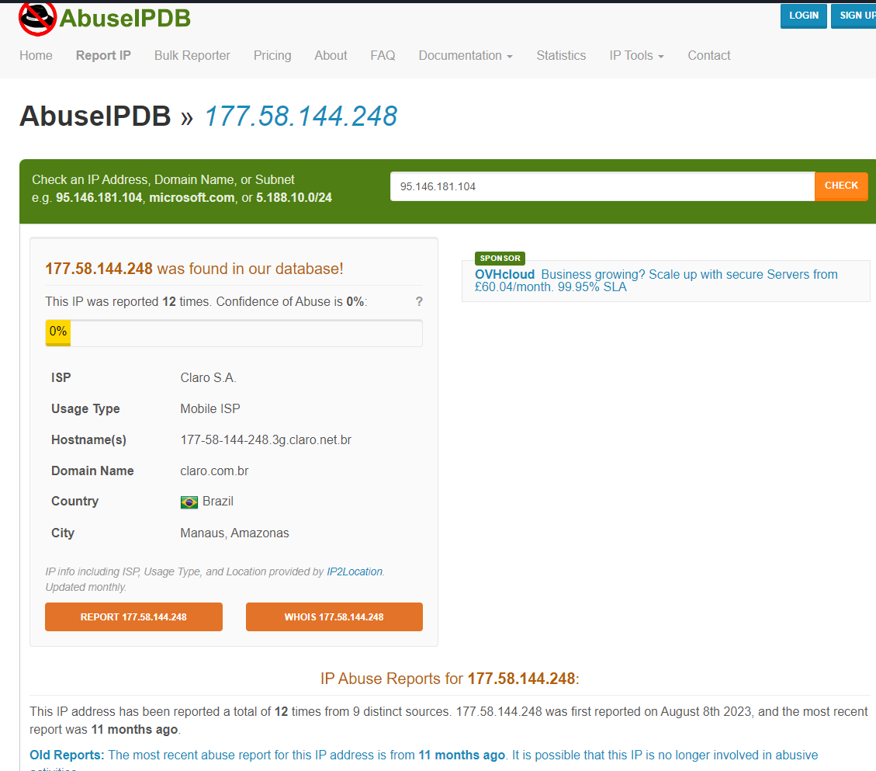
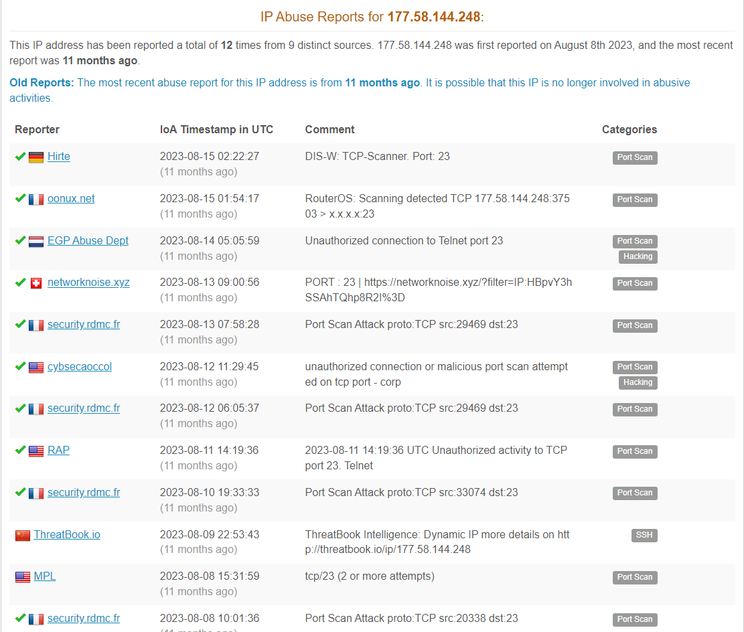
IP: 177.58.144.248 | Date and Time: April 2, 2019, 17:59:59 | Source IP: 10.1.5.16 | Destination Port: 20 (FTP)

Slide 12
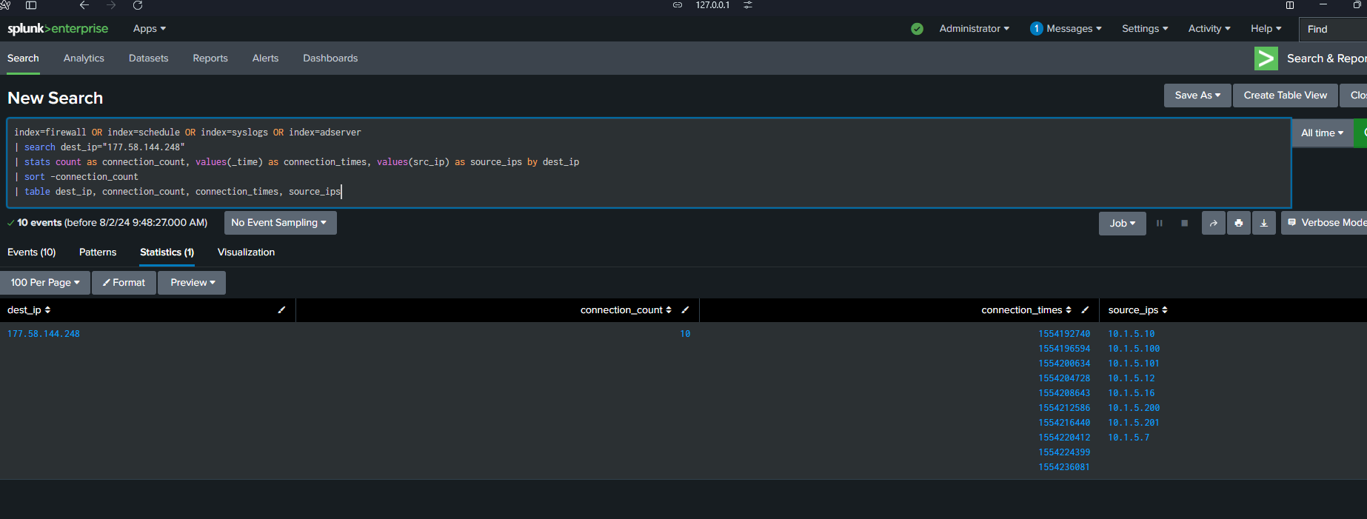
Potential Malicious Activity: Indications of Unauthorized Access Attempts

Slide 13
Regular Intervals:
Connections occur at regular intervals from the evening of April 2 to the early morning of April 3.
Indicates possible automated processes or scripts.
Such patterns are often linked to malicious activities like data exfiltration or backdoor communications.
Time of Day:
Activity takes place late at night and continues into the early morning.
Unusual timing for legitimate business activities, increasing suspicion.
May suggest an attempt to avoid detection by operating during non-business hours.
Frequency and Duration:
Unusual frequency and extended duration of connections.
No known legitimate business need for these communications with an external IP during these hours.
Consistent Source and Destination:
Persistent communication between internal network and the same external IP (177.58.144.248).
Indicates focused interaction, which is atypical and warrants further investigation.
External IP is flagged, increasing the need for scrutiny.
Potential Risks:
The external IP’s reputation and use of FTP on port 20 pose significant risks.
High likelihood of unauthorized data transfer from your network.
Potential for data breach or ongoing data exfiltration.
Converted Timestamps:
April 2, 2019, 06:32:20 PM
April 2, 2019, 07:36:34 PM
April 2, 2019, 08:43:54 PM
April 2, 2019, 09:52:08 PM
April 2, 2019, 10:57:23 PM
April 3, 2019, 12:03:06 AM
April 3, 2019, 01:07:20 AM
April 3, 2019, 02:13:32 AM
April 3, 2019, 03:19:59 AM
April 3, 2019, 06:34:41 AM

Slide 14
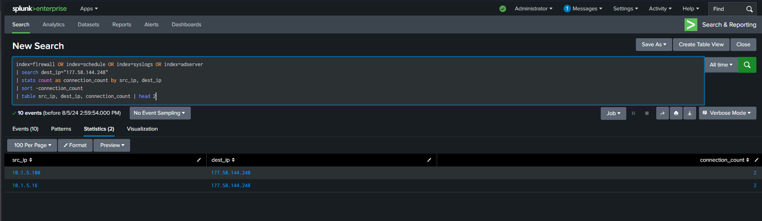
Internal Network Engagement: Evidence of Potential Compromise

Slide 15
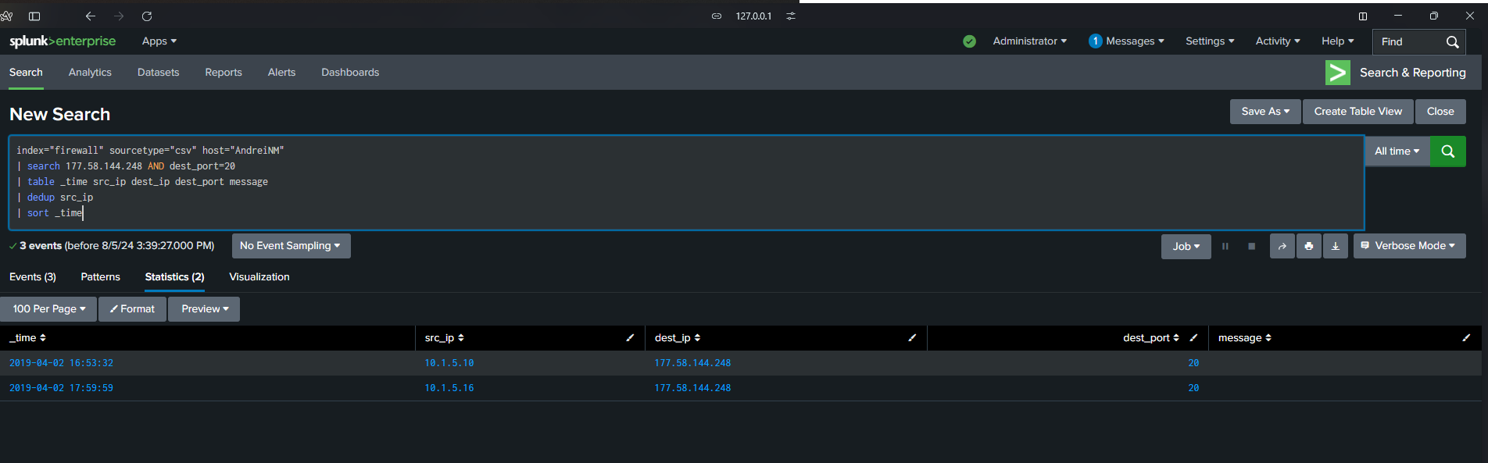

Slide 16
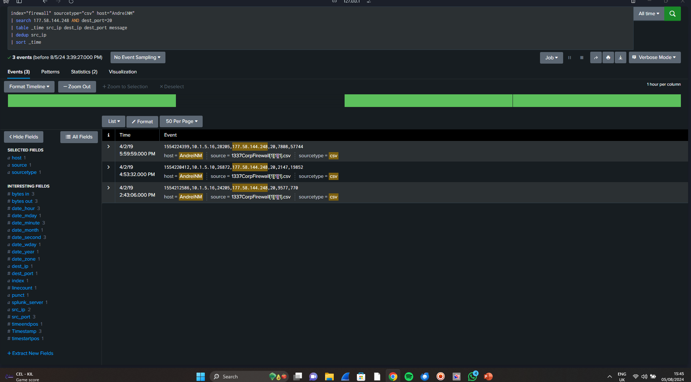
Notes:
Multiple Connections: There are three different time logs indicating connections between your internal IP addresses (10.1.5.10, 10.1.5.16, and 10.1.5.18) and the external IP 177.58.144.248 using FTP on port 20. This shows repeated activity.

Slide 17
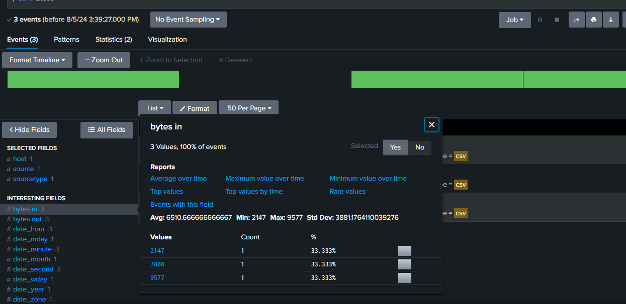
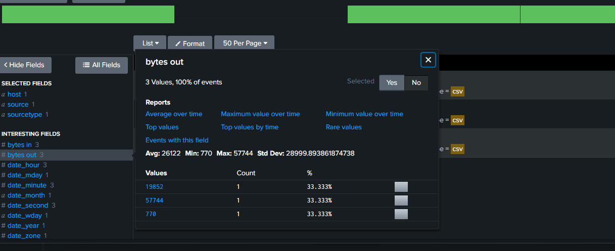
Potential security issues such as data exfiltration or backdoor activity
Bytes in
Bytes out
Notes:
The evidence suggests potential security issues such as data exfiltration or backdoor activity. It's crucial to prioritize this investigation, given the nature and pattern of the connections. Conducting a thorough analysis and involving security professionals can help mitigate risks and safeguard your network effectively.

Slide 18
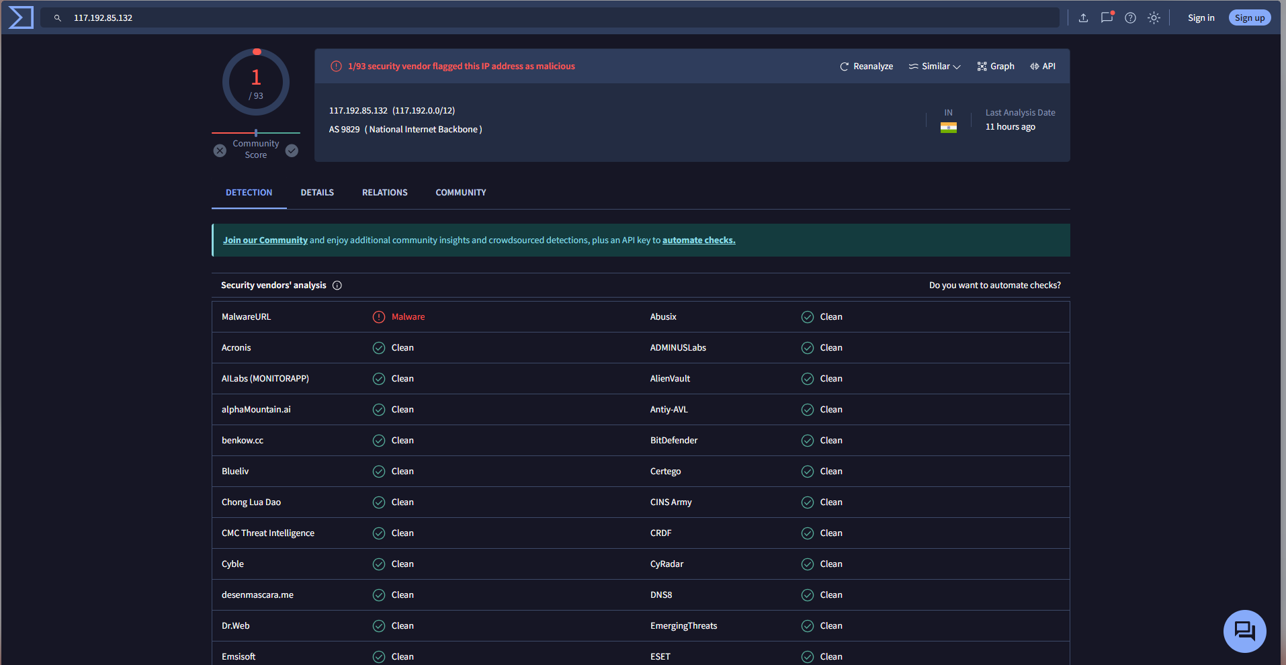
Suspicious Network Activity Detected: FTP Connection from 10.1.5.18 to Malicious IP 117.192.85.132 on April 2, 2019, at 17:42:36
Notes:
The IP address 117.192.85.132, part of the BSNL Broadband infrastructure, has been flagged for suspicious activities. As it is linked to a major ISP in India, traffic from this IP should be carefully monitored for potential data exfiltration and unauthorized access attempts. Coordination with BSNL’s abuse desk is recommended for further investigation and mitigation.

Slide 19
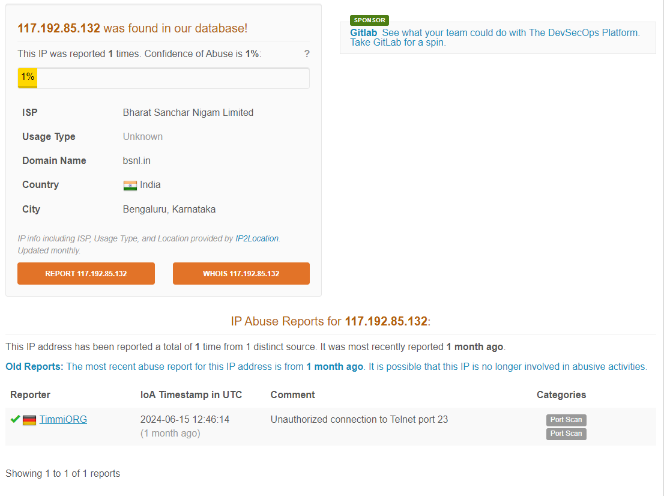
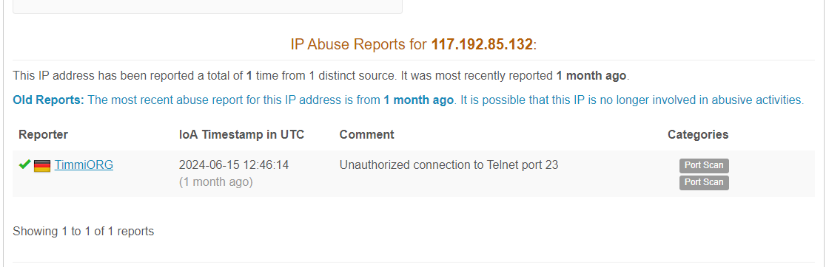
Notes:
Security Concerns:
Unauthorized Connection: The report indicates a potential security risk due to unauthorized attempts to connect to Telnet, which is known for weak security.
Port Scan Activity: The presence of port scan activity may signal reconnaissance efforts by a potential attacker.

Slide 20
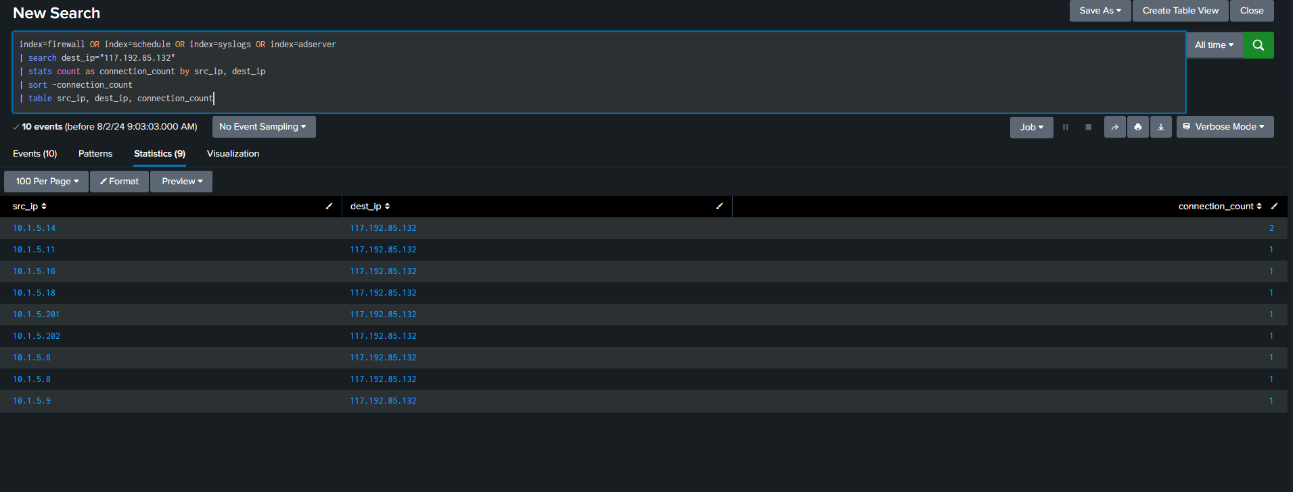

Slide 21
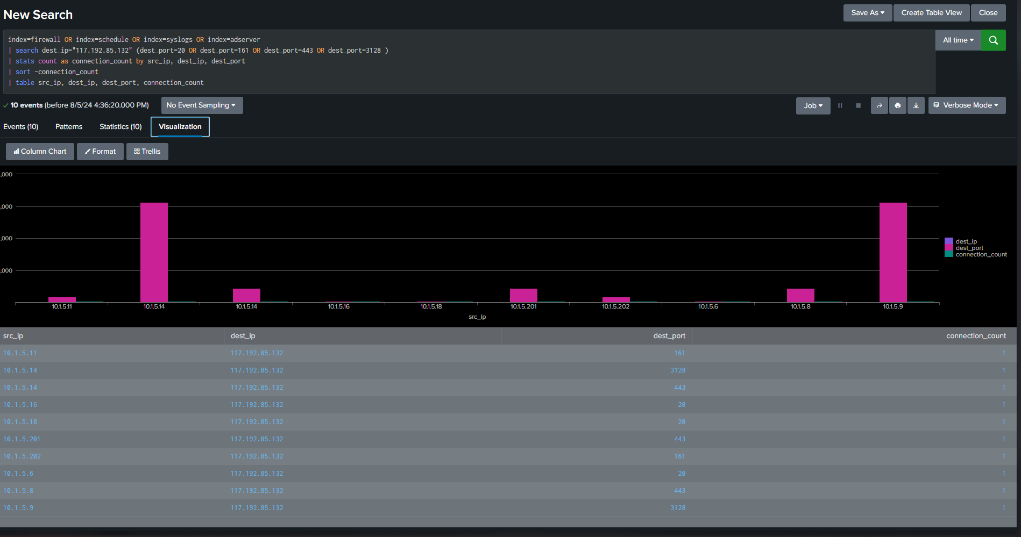
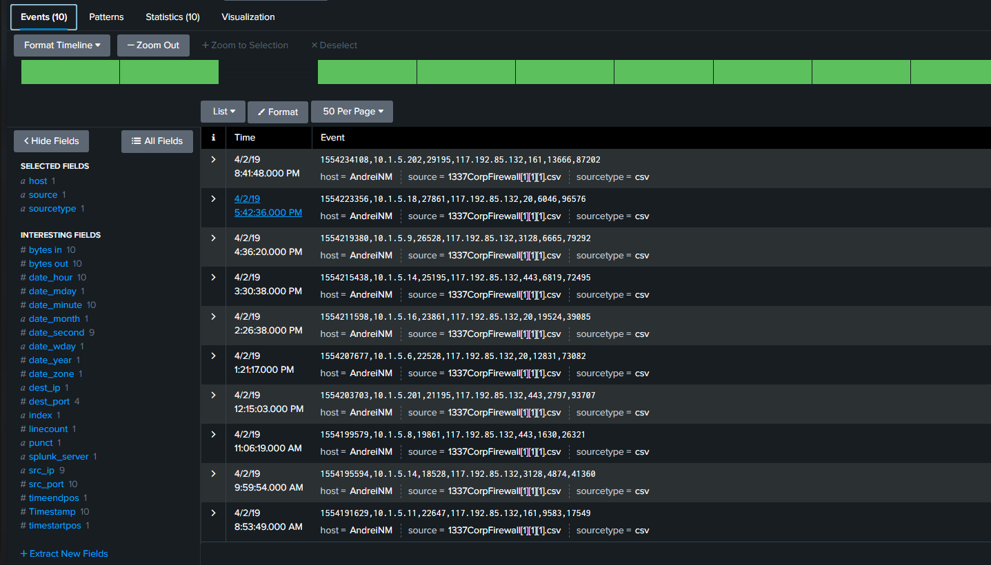

Slide 22
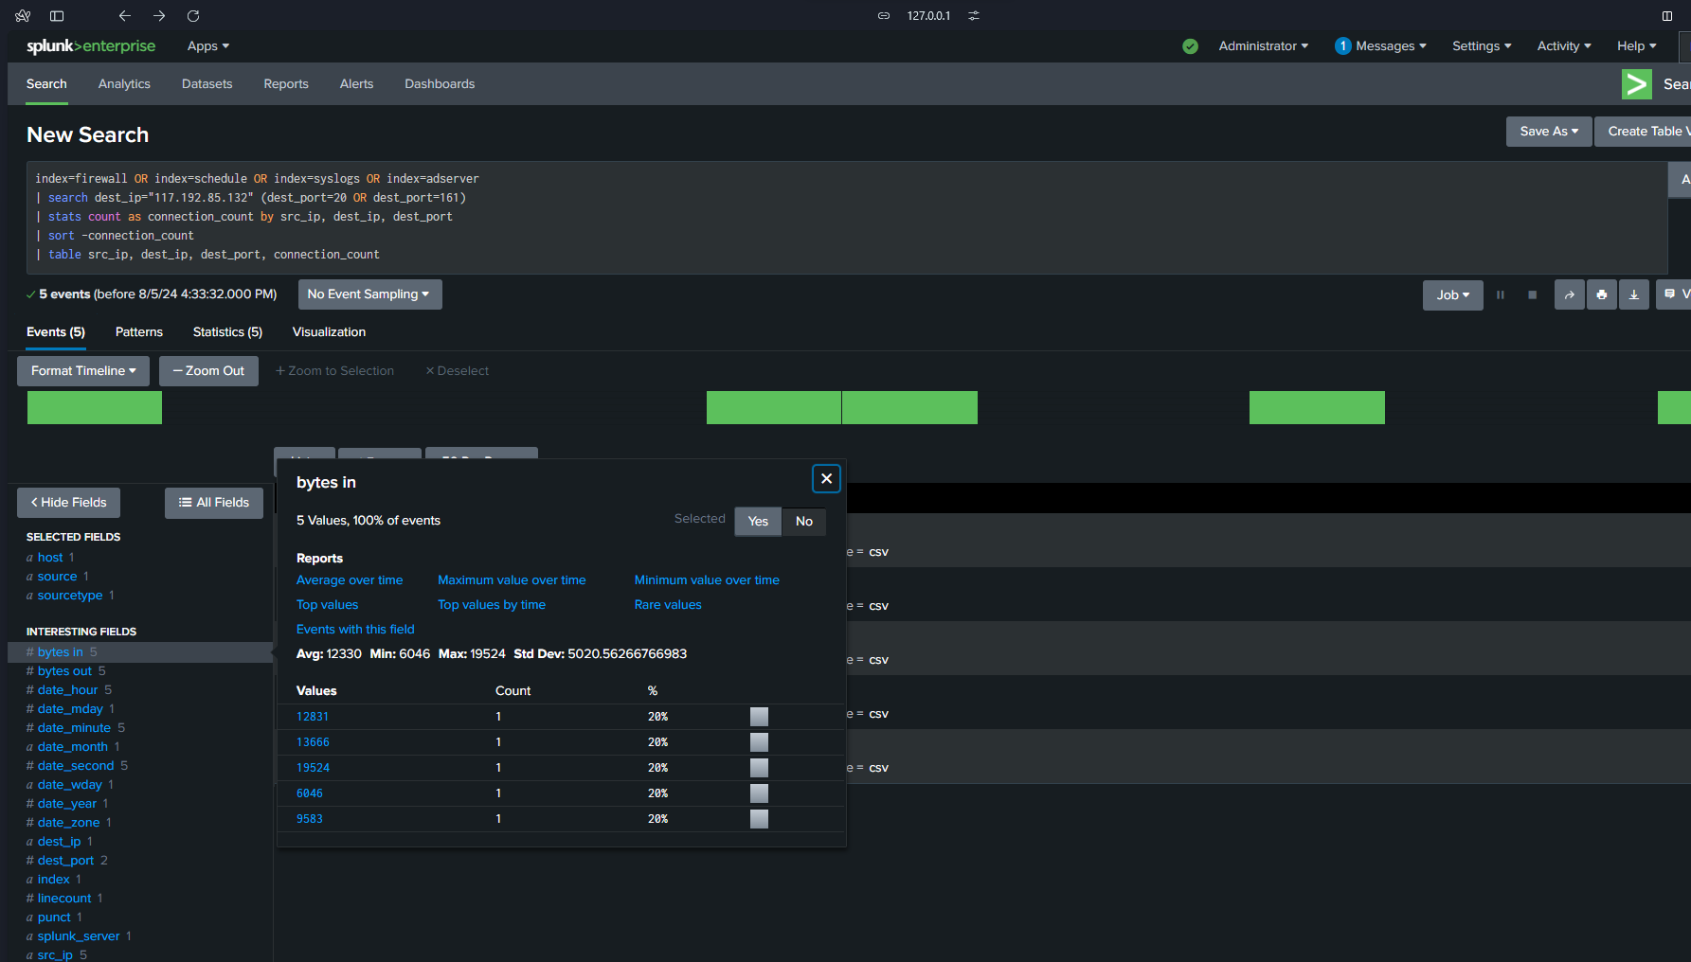

Slide 23
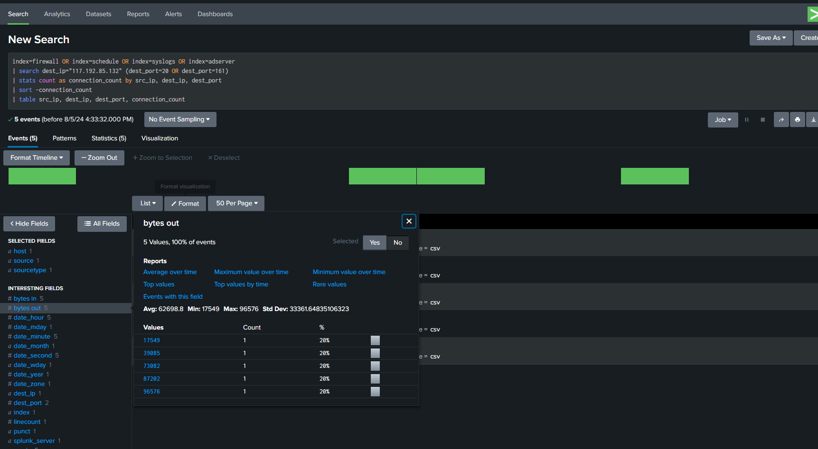

Slide 24
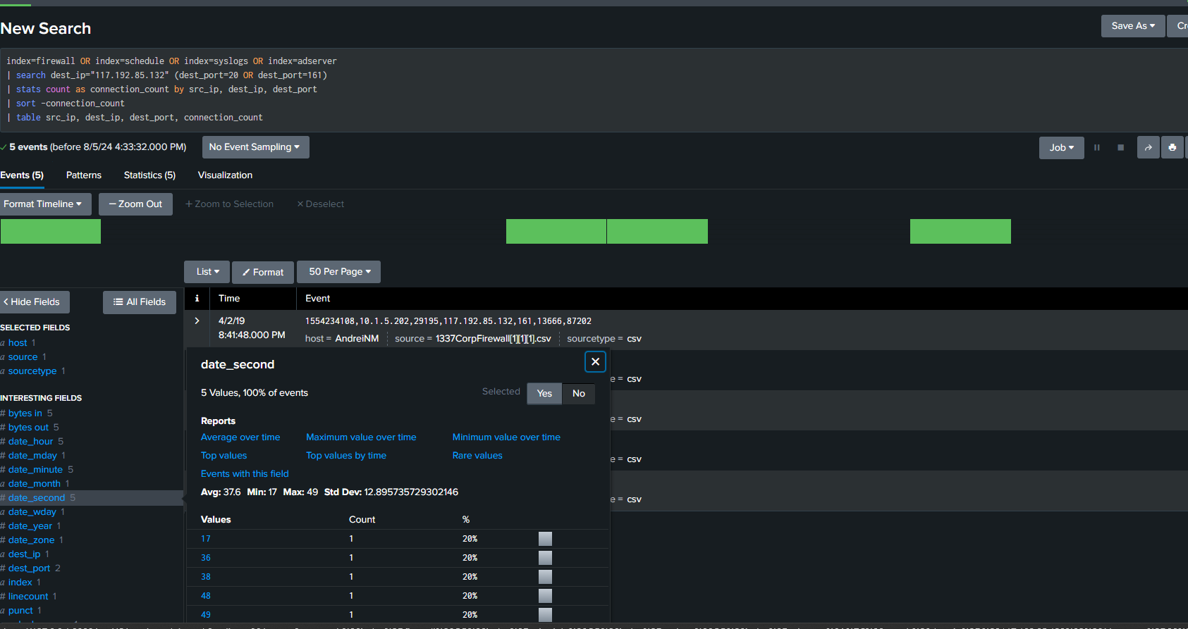

Slide 25
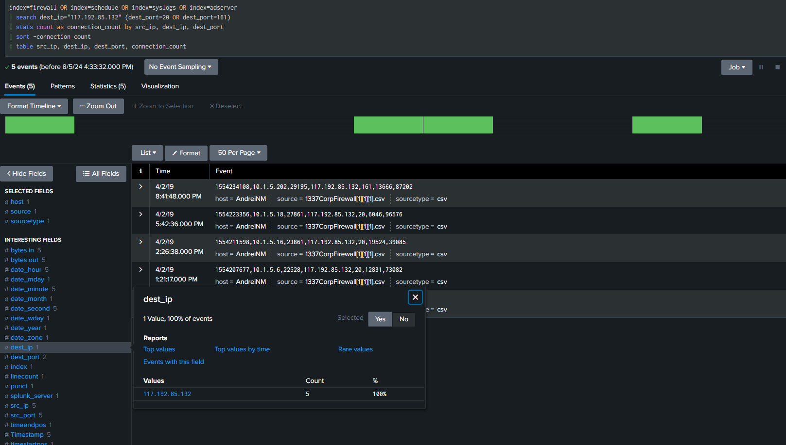

Slide 26
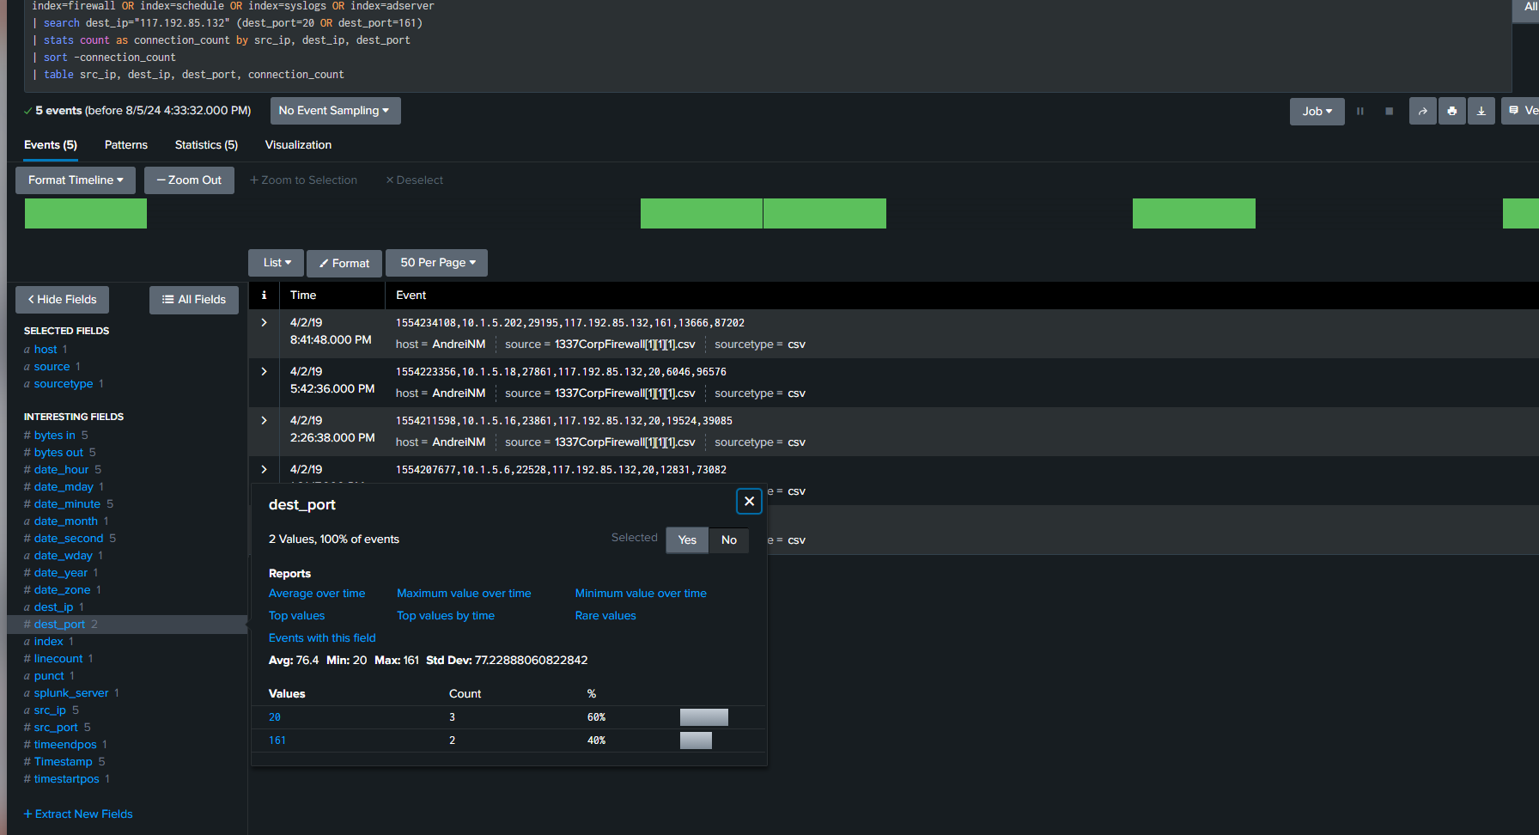

Slide 27
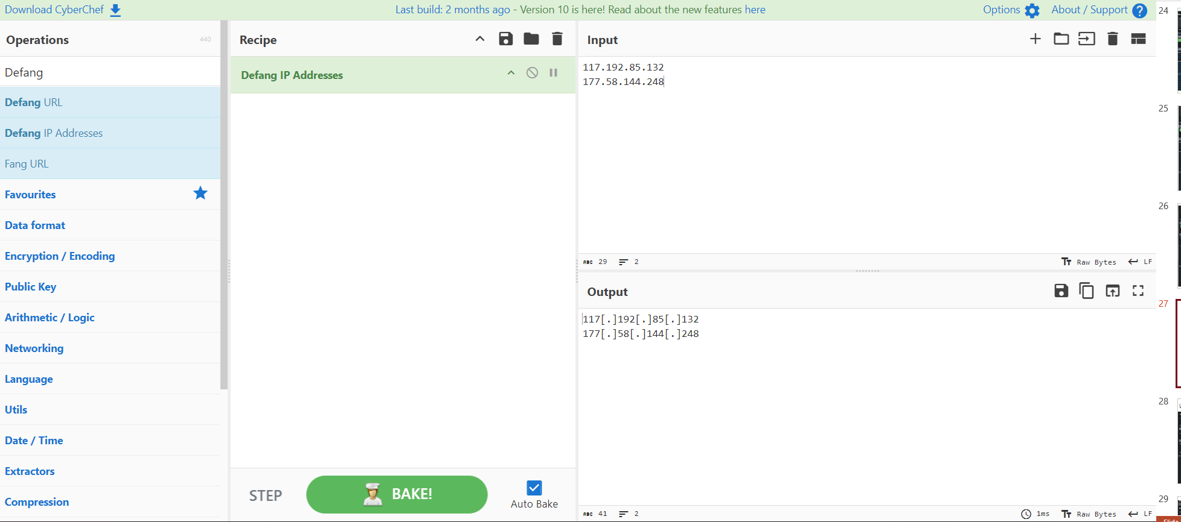

Slide 28
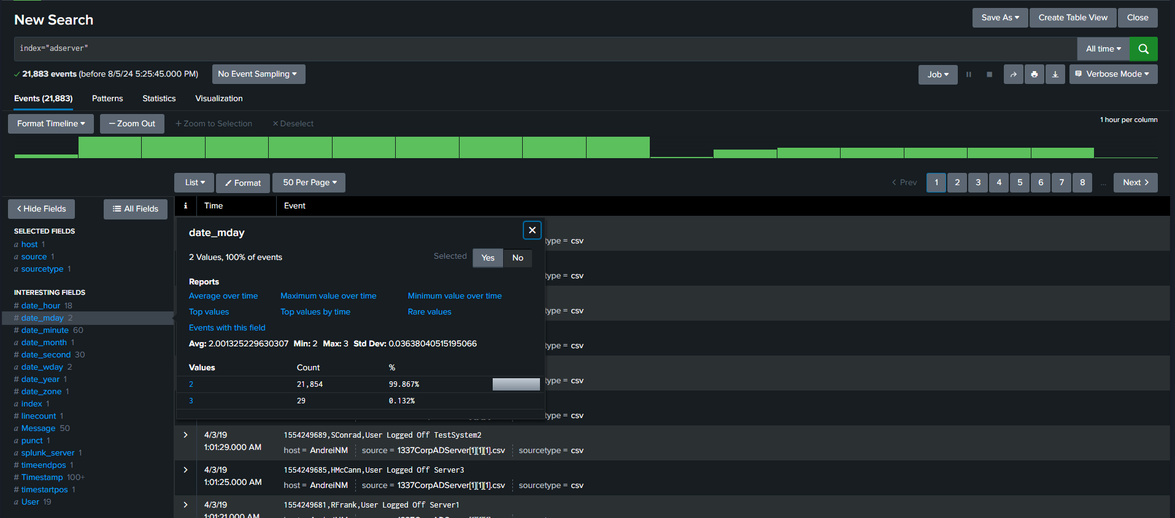
Unusual User Activity

Slide 29
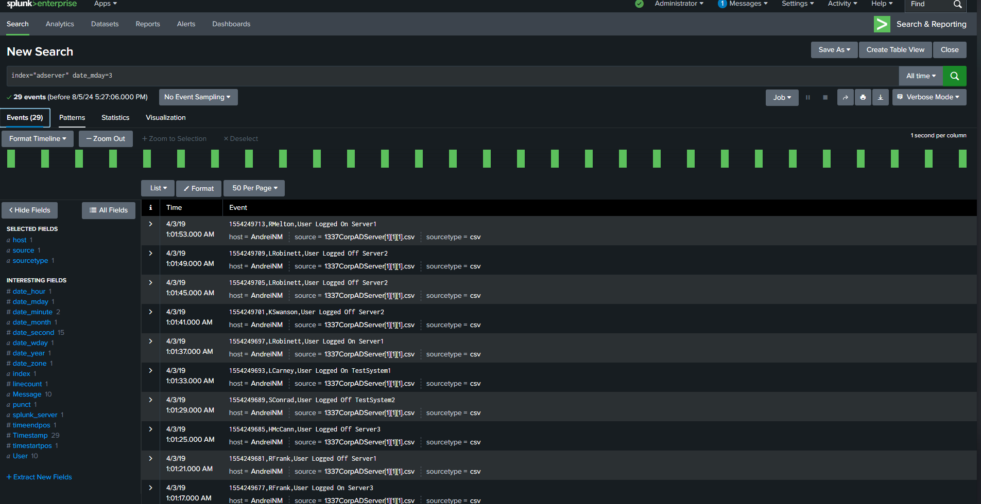

Slide 30
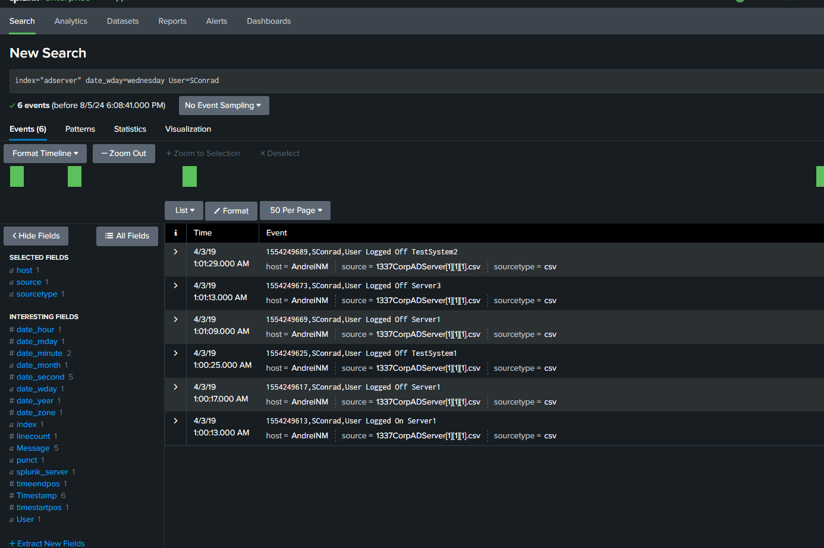
Notes:
Lack of Corresponding Logons:
Logoffs occur without preceding logon events in some cases.
Unusual for typical user sessions.

Slide 31
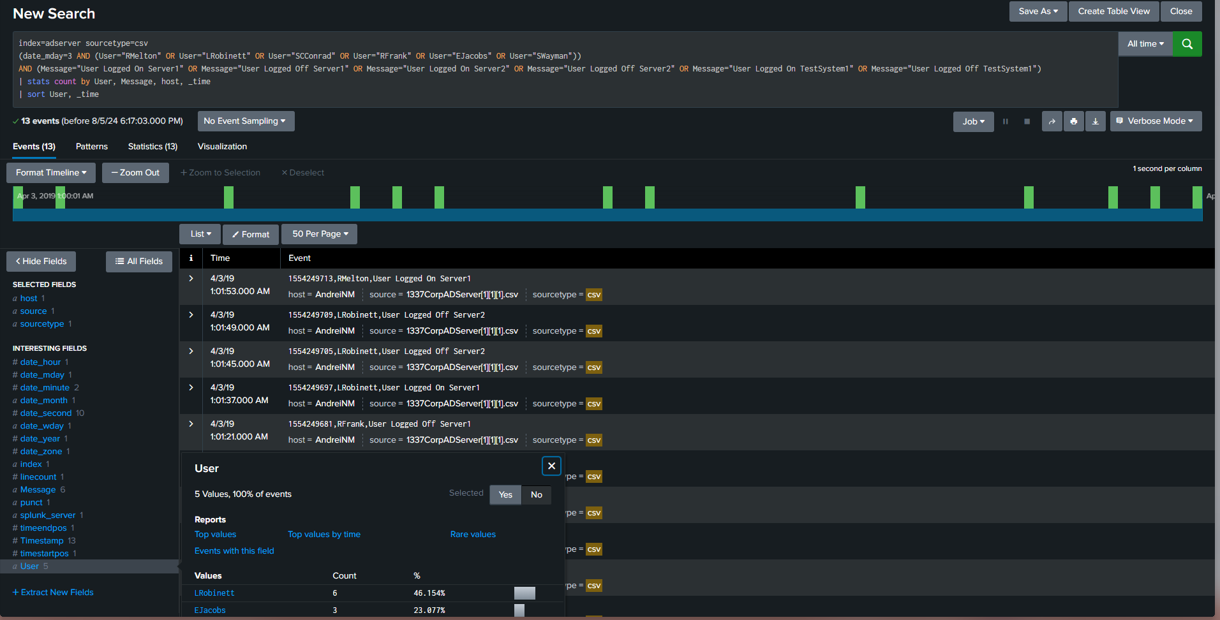

Slide 32
